Slide 1
Southwest Michigan Advanced Research & Technology Park
Project Update
February 7, 2023

Slide 2
About SMART Park
Midwest Energy & Communications (MEC) acquired nearly 500 acres in Penn Township and the Village of Cassopolis, Michigan for the purpose of constructing a new headquarters on approximately 70 of those acres at the corner of M-60 and Decatur Road as well as a 0.8 MW community solar array on 20 adjacent acres.
Having approximately 400 acres of undeveloped land remaining, MEC has partnered with the Village of Cassopolis and Penn Township to invest in its future and the future of rural Michigan by pursuing the development of a business and industrial park to promote community resiliency and job creation.
The Southwest Michigan Advanced Research and Technology (SMART) Park is planned to be a business and industrial park that will entice prospective tenants with flexible parcel sizes that can accommodate large facilities along with a well-planned transportation system.

Slide 3
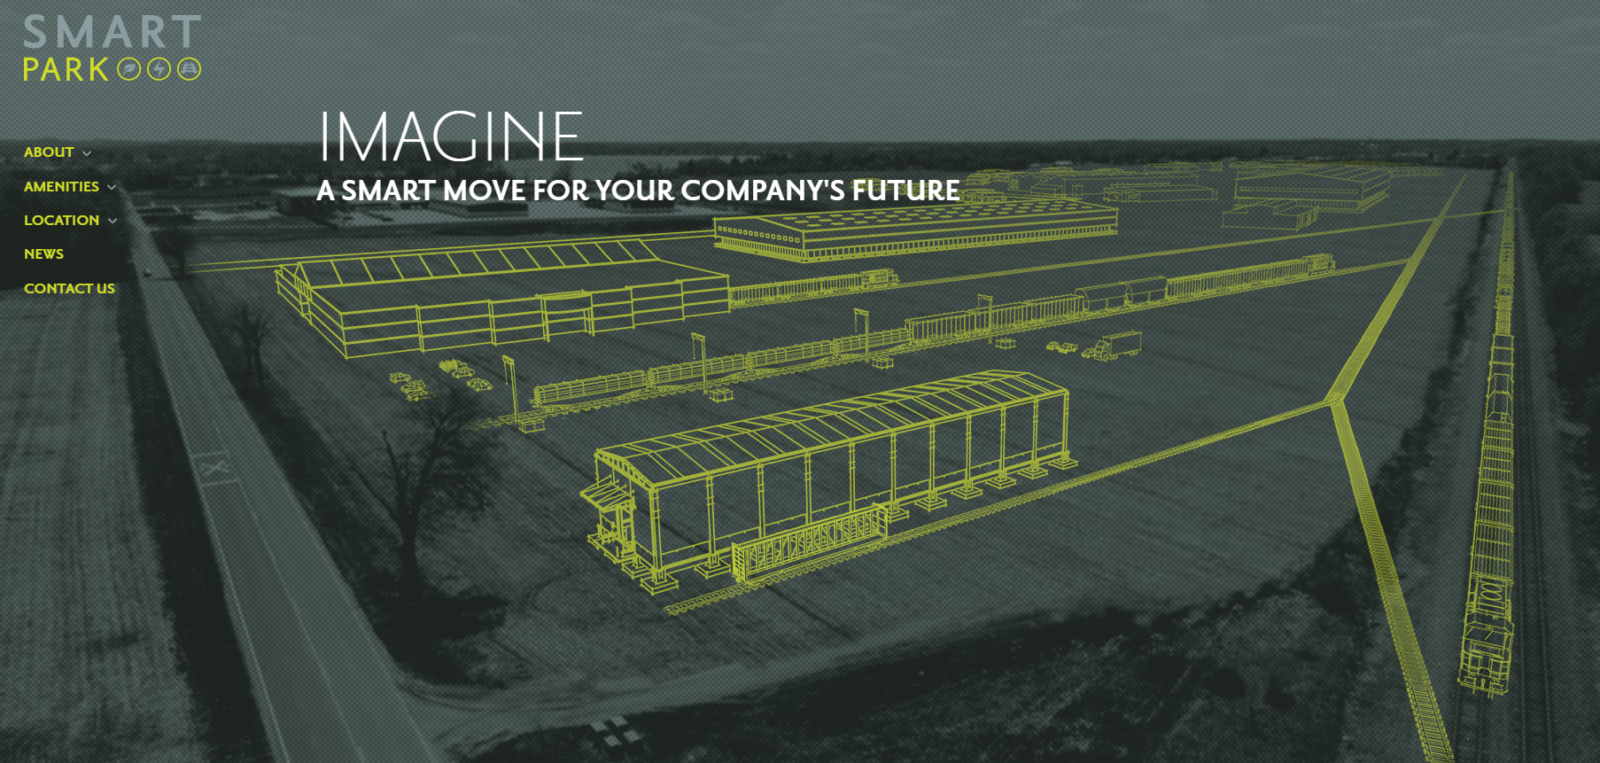
About SMART Park
https://www.imaginesmartpark.com/

Slide 4
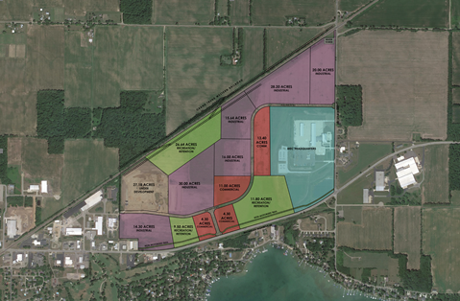
About SMART Park
Land use planning for the project was done in a manner to be sensitive to surrounding community land uses in the area.
The land use planning for SMART Park calls for the majority of the land along M-60 to be commercial or open space.
The northern portion of the Park along the CN rail line is planned to be industrial in nature.

Slide 5
About SMART Park
Commercial Development Strategy
Commercial development clusters are organized around the high visibility M-60 corridor, the primary entry access road from M-60, and adjacent to the MEC Data campus to leverage the fiber network strengths of their Headquarters location. Based on the target market analysis performed by Thomas P. Miller and Associates, along with the preliminary business analysis performed by McClure, the following were identified as commercial development targets:
Medical/dental/vision
Professional offices – data driven (engineers, attorneys, etc.)
Restaurant (1-2)
Day-care Facility
Lodging Financial Institution
Co-working/Makers Space or Artists/Artisan Workshops

Slide 6
About SMART Park
Industrial Development Strategy
Industrial development clusters are organized around the access to the CN rail spur and are oriented to the lower visibility areas in the Park. As a means of providing separation between the auto and truck traffic, industrial users will be driven to use the Follett Drive and Decatur Road accesses. Based on the target market analysis performed by Thomas P. Miller and Associates, the following were identified as industrial development targets:
Primary Industrial Targets
Advanced Materials Manufacturing
Plastics, Metals, and Motor Vehicle Parts
Wood and Paper Products Manufacturing
Furniture, Wood Products, and Converted Paper Products
Ag-Related Industrial Site Targets
Breweries
Grain Handling and Processing
Added Value Agricultural Products Manufacturing
Food Grade Manufacturing

Slide 7
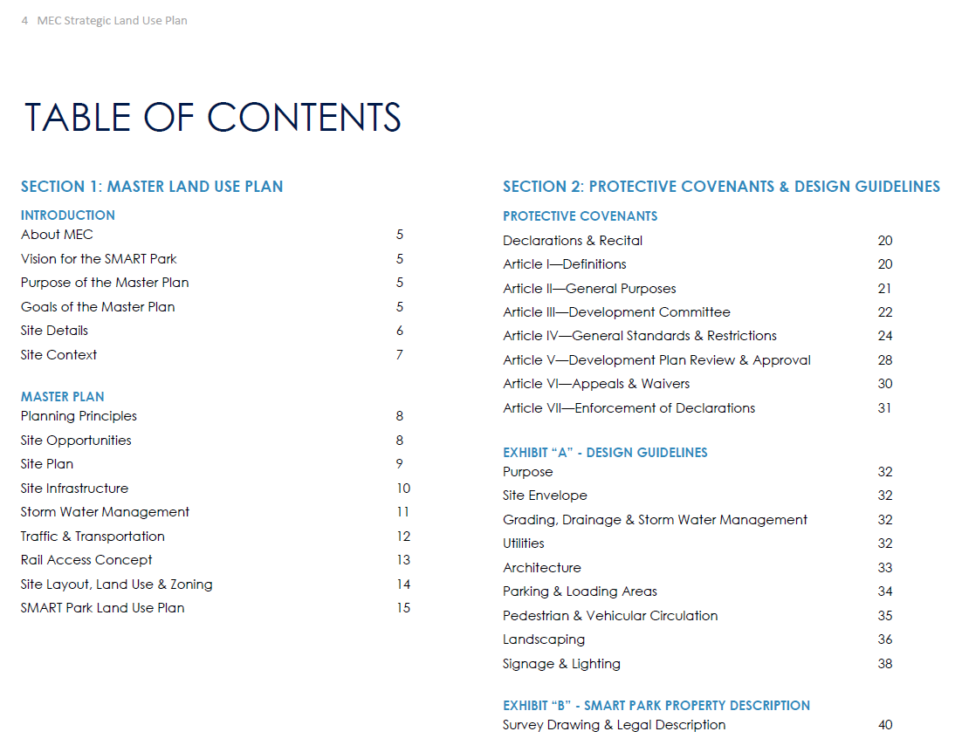
SMART Park Covenants
MEC spent a great deal of time, energy and resources developing its new headquarters on the western edge of the Park along Decatur Road.
A world-class development is important to the staff and Board of Directors at MEC to ensure the project is aligned with the values and vision of the organization and community.
To ensure a high standard of development within the Park, a Strategic Land Use Plan with protective covenants and design standards was developed to guide the Park’s overall development.
This Plan was adopted by the Village of Cassopolis as part of the rezoning process for the property.

Slide 8
Community Partnership
Penn Township
While MEC has operated as the lead partner for many aspects of the Park’s development, getting the project to this point has been a partnership between Penn Township, the Village of Cassopolis, the Cassopolis Area Utility Authority, and MEC.
The project contains land that was within the borders of both Penn Township and the Village of Cassopolis.
To create efficient delivery of services and consistent local regulatory requirements across the entire Park, the Township and Village voluntarily entered in a PA 425 contractual land annexation agreement where each party had defined roles in the development and operation of the Park.
Under the agreement:
The Township provides water for the Park
The Village provides sanitary sewer services for the Park
The Village is responsible for enforcing zoning and building regulations within the Park as well as for the provision of public safety services
The Township was held harmless as to its collection of taxes for the portion of its property within the Park and will receive taxes under the same standard as before the 425 agreement was executed

Slide 9
Public Services and Utilities
SMART Stormwater Management
One of the driving design guidelines for the Park was to be conscious of how it may impact the surrounding community.
To that end, a stormwater management system was designed to capture/detain stormwater within the boundaries of the Park.
The stormwater management approach for the larger SMART Park development will follow and build on the approach of the MEC Headquarters site. A single site solution was developed to manage and direct all of the stormwater from the site into common retention areas.
Given the sandy soils found within the site, it is anticipated that the basins, similar to the bioswales, will remain natural to aid in the natural filtration of the run-off.

Slide 10
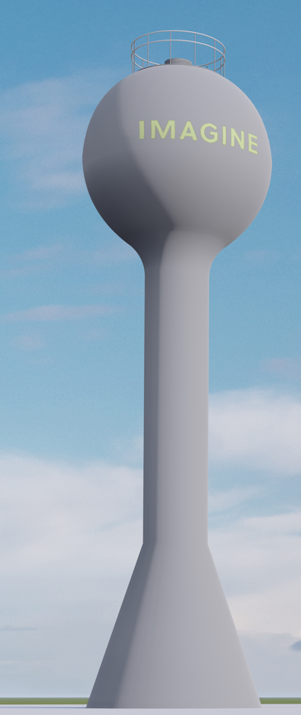
Public Services and Utilities
SMART Park Water
Water for the project will be provided by the Penn Township.
The system is supplied by two (2) ground water wells located in Penn Township and has four (4) emergency interconnects with the Village of Cassopolis. The system provides an average daily demand of l 00,000 gallons. One elevated storage tank on the east side of Vandalia, with a capacity of 150,000 gallons, provides all of the storage for the system. A second 150,000-gallon elevated storage tank will be constructed on the SMART Park site.
Before the construction of the new 150,000 elevated storage tank, the system has a capacity of 120,000 per day. During the twelve (12) months analyzed for the project, the average daily use has ranged between 6.8% and 9.3% of the system's capacity. While not needed for capacity purposes currently, the new water tower will significantly improve pressures and fire flows in the area as well as ensure capacity is available in the future when needed.

Slide 11
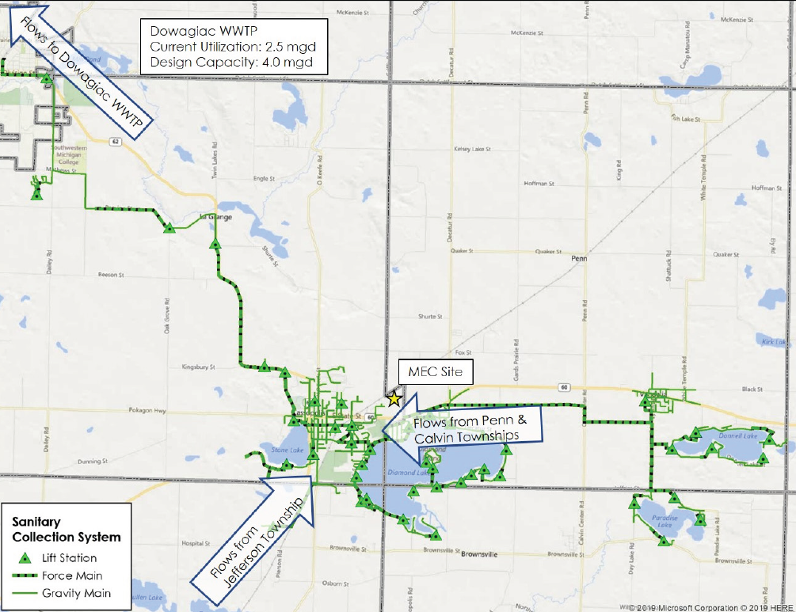
Public Services and Utilities
SMART Park Sanitary Sewer
The sanitary sewer flow from the Park will be handled by the Village of Cassopolis and treated at the Village of Dowagiac’s wastewater treatment plant (WWTP) via an agreement with the Cassopolis Area Utility Authority.
When the area utility systems were evaluated in 2019 for the project, the plant was using 2.5mgd of its 4.0mgd capacity.
The plant has plenty of capacity to treat wastewater from the Park. The limiting factor to the amount of wastewater generated by the project is the collection system to carry the waste to the WWTP.
Improvements are being made to the system to increase the capacity from the site by up to 200,000 gallons per day. This is still a fraction of what the water supply system can generate which, in turn, serves as an additional tollgate to water usage by the Park.

Slide 12
Public Services and Utilities
Utility System Improvements
As detailed in the previous two slides, there are planned improvements to both the water and sanitary sewer systems to support the development of SMART Park.
The water system improvements will include the construction of a new water tower that will increase fire flows for the area as well as ensure the capacity to serve long term usage needs.
The sanitary sewer system requirements will include upsizing existing force mains as well capacity upgrades to the lift station which also serves Diamond Lake. This will benefit the sewer reliability and capacity for the residents around the lake.
Like the infrastructure improvements within the Park, these capital improvements are being undertaken without any requested funding from either the Village of Cassopolis or Penn Township.
While these improvements are necessary for the development of the Park, they have benefits to the broader community beyond the SMART Park project itself.

Slide 13
Public Services and Utilities
In addition to new roads within the Park, the project team is developing a new 10’ non-motorized trail along M-60 that will help enhance non-motorized transportation opportunities for the users of the Park as well as the surrounding community.
This planned trail is serving as a catalyst that has brought together a group of organizations that are working on planning and constructing a non-motorized route from the Village all the way to Dr. T.K. Lawless Park.
Penn Township

Slide 14
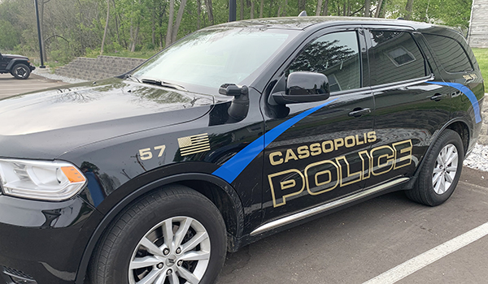
Public Safety
As part of the PA425 contractual land acquisition developed between Penn Township and the Village of Cassopolis, the Village will be responsible for providing public safety for the Park.
The Village of Cassopolis has a full-time police force which provides law enforcement services 24/7 365 days per year committed to the safety of residents and businesses.
The Village of Cassopolis and SMART Park are to be served by the Central Cass Interlocal Fire Department.
Both of these agencies have mutual aid agreements with surrounding departments ensuring that public safety resources are available regardless of need.

Slide 15
Regulatory and Environmental Oversight
Numerous governmental agencies have made investments into SMART Park including the:
U.S. Department of Agriculture;
Michigan Department of Transportation;
Economic Development Administration; and,
U.S. Department of Housing and Urban Development
All of these agencies require a project conform to the requirements of the National Environmental Policy Act (NEPA)of 1970.
In short, NEPA was enacted to make sure that a project would not have a negative impact on the environment or that the environment would have a negative impact on the project.
The project was required to secure NEPA clearance and approvals before any work began. Beyond environmental considerations, this approval required a review of potential impacts of the project on historical or cultural resources of the area.

Slide 16
Regulatory and Environmental Oversight
Once the infrastructure for the Park has been completed, a significant amount of the oversight of businesses located in the Park will be under the purview of the Michigan Department of Environment, Great Lakes and Energy (EGLE).
EGLE is the State’s regulatory agency charged with approving and monitoring items such as air pollution, site specific stormwater quality, hazardous waste management.
While the State is the regulatory agency setting the standards and ensuring compliance with items above, there are areas where MEC and the Village can set standards above what is required of the State.
For example, the design standards for the Park are currently being tightened from “encouraging the use of dark sky friendly lighting” to requiring its use within the Park for all users including the public infrastructure currently under construction. This will ensure that SMART Park contributes no light pollution to the community’s skies.

Slide 17
Regulatory and Environmental Oversight

Slide 18
Community Impacts and Benefits
The project is expected to have a significant impact on the revenue available for reinvestment into the community.
The Village is doubling its tax base as the result of the Park’s first project. This will help in a number ways including investments in parks and infrastructure as well as other services to include, but not limited to, police, fire and EMS in and around the Village of Cassopolis. In short, the project has the potential to create new resources within the community that the community gets to decide how its wants to reinvest those resources back into itself.
Based on a study completed by Kinexus as part of the EDA grant for the project, SMART Park has the ability to create over 1,000 new jobs for our community.
Many of our community’s residents are forced to travel 30 or more minutes for employment. Not only will the proposed project create opportunities closer to home for residents, it also has the potential to bring new residents to the community for better job opportunities. This will stem years of out-migration from the community and support local businesses and institutions such as the public schools.

Slide 19
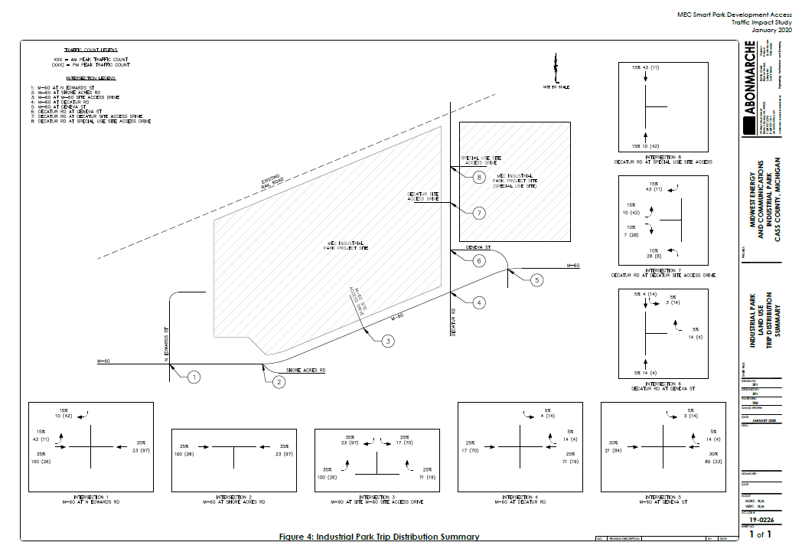
Community Benefits and Impacts
Two (2) questions that have been discussed since the initial planning stages of the project is the potential impact on housing and traffic within the community.
Traffic
As the project abuts both County and State roads, both the Cass County Road Commission and Michigan Department were required to review the plans for the project to ensure traffic flow along Decatur Road and M-60 would not be negatively impacted by the project.
In 2020, a traffic study for the project was approved by both agencies.
One change being incorporated into the project from the study will be the development of turning lanes and blisters along M-60 along the main entrance to the Park.

Slide 20
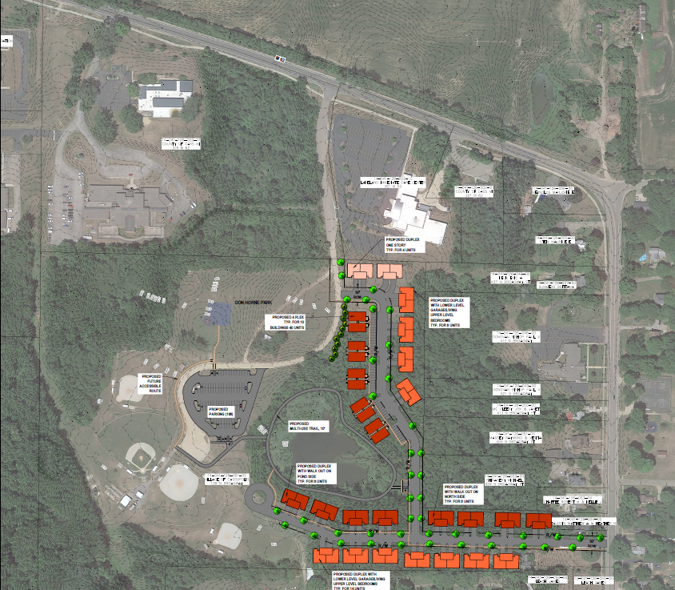
Community Benefits and Impacts
Housing
Even before the planning for SMART Park began, housing was an issue being discussed in the community. The need for more and an increased diversification of housing options was a common discussion during the Imagine Cass community public engagement process.
As alluded to earlier, there are significant numbers for skilled workers leaving our community daily for jobs elsewhere. Initial hiring for the businesses in SMART Park is expected to focus on these individuals.
That does not mean the project team is taking a laissez-faire approach to housing development.
The Village of Cassopolis, in collaboration with Abonmarche, are actively working on housing development project concepts within the community, both on parcels owned by the Village as well as ones that may be able to be acquired for development. Work will continue in earnest in this area during 2023.

Slide 21
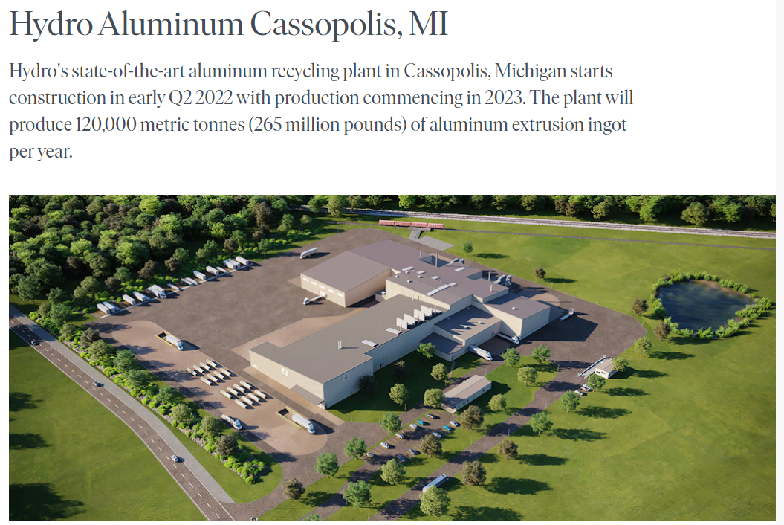
Activities Completed and Underway
The project has garnered interest from site selectors at both a higher level and sooner than anticipated.
Hydro has been the first company to commit to SMART Park.
Hydro’s commitment to the area extends beyond the Park, underscoring the type of companies and good corporate citizens the Park is working to attract.
Infrastructure buildout for the Park began in the fall of 2022 and will be substantially completed in the 2023.
Off-site utility improvements are scheduled to occur in 2023 and 2024.

Slide 22
Questions and Discussion

Slide 23
